Slide 1


Department of BES-I
COURSE: Data Structures through Python
COURSE CODE: 24SC1204
Topic:
Name of the topic:
Construction of B-Tree
Session – 30

Slide 2



AIM OF THE SESSION
To familiarize students with the basic concept of B-Tree.
INSTRUCTIONAL OBJECTIVES
This Session is designed to:
Demonstrate The Concept of B-Tree.
Describe the concept of m-way ordered Balanced Tree.
List out the operations possible on the construction of B-Tree.
Describe the each operation.
List out the advantages and applications of B-Tree.
LEARNING OUTCOMES
At the end of this session, you should be able to:
Define Construction of B-Tree.
Describe three different ordered of B-Tree. And their operations.
Summarize definition, types and operations of construction of B-Tree and its applications.

Slide 3
Construction of B-Tree
INTRODUCTION
B-Tree is a balanced m-way tree.
Generalization of BST in which a node can has more than one key and more than two children.
Maintain Sorted (ascending order) data.
All leaf nodes must be at same level.
B-Tree of order m has following properties
* Every node has maximum m no of children
*Minimum children : leaf node-> 0
root -> 2
internal nodes -> ceiling(m/2)

Slide 4


Every node has maximum (m-1) keys.
Minimum keys:
        Root -> 1.
        All other nodes -> ceiling(m/2) – 1.

Slide 5
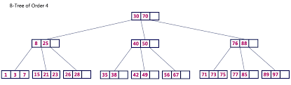
Example of Construction of B-Tree 4 order

Slide 6
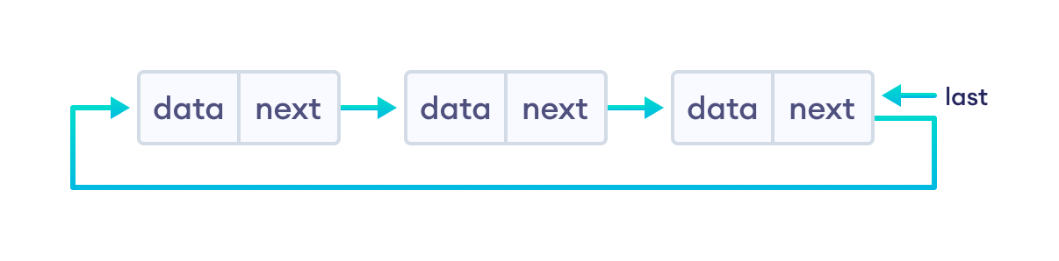
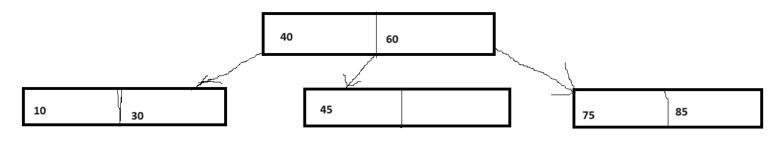
Types of B-Tree Cont…
1. Order 3 balanced B-Tree:
Here, each node can holds max 2 keys.
Circular Singly linked list

Slide 7

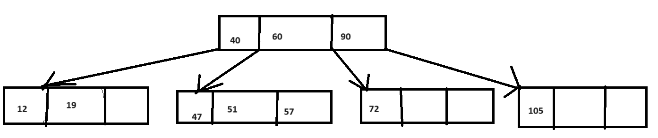
Order 4 balanced B-Tree:
Here, each node can holds max 3 keys.

Slide 8
OPERATIONS ON B-Tree
(Cont..)
In a B-Tree, we can perform the following operations...
  Insertion
  Deletion
  Display

Slide 9

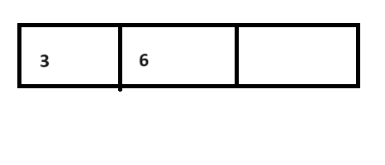
Steps for insertion an element in a B-Tree (Cont..)
Always insert element at leaf node and in sorted manner.
Before insert check no of keys at that node. Maximum no of keys are possible in a node is m-1.
Explain with example:
Insert all the following numbers in a B-Tree having m=4.
6, 3, 12, 10, 5.
As m=4, so maximum no of keys are possible ia a node is 3.
First insert 6:
Next Insert 3. As 3 is less than 6 so it comes at left side of 6.

Slide 10
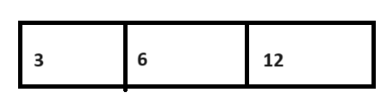
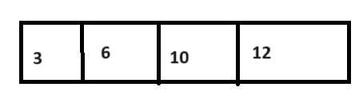
Insertion
Next Insert 12. As 12 is greater than 3 as well as 6. So it comes right side of 6.
Next insert 10. 10 is greater than 6 but less than 12. so it comes in between 6 and 12
But here, the problem is number keys of the above node are 4 which is more than the value of m-1(as m=4). So we have to sent the middle element of the node towards the up node.

Slide 11
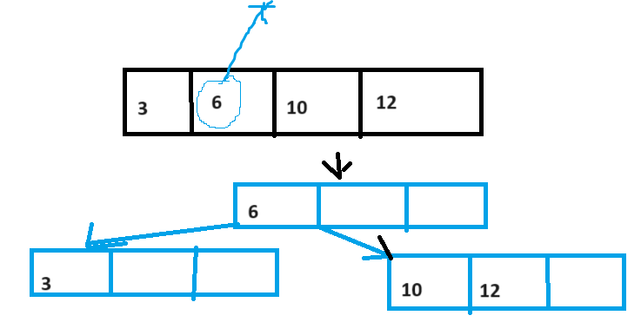
Insertion
Here middle elements are 6 and 10. We can send any one. If we send 6 to upwards then it is called Left Biased. If we send 10 to upwards then it is called Right Biased. Let, we consider Left Biased.

Slide 12
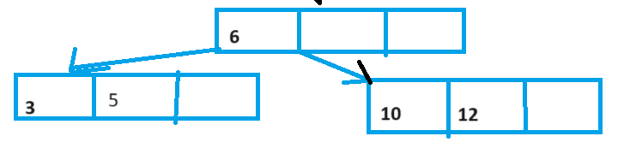
Insertion
Next element is 5. We have to check from root node. 5 is less than 6, so it goes to the left child node of 6. Next we have to compare with 3. 5 is grater than 3 so it comes right side of 3. Always insert at leaf node.

Slide 13
IMPORTANT FACTS RELATED TO THE SESSION
Advantages of a B-Tree
B-Tree can Balance themselves
High throughput and concurrency
Efficient use of storage space
Disadvantages of B-Tree
B-Tree require more space
Not efficient for write-heavy workloads.
slow
Applications/Uses of B-Tree in real life
Database system
File Organisation
Information Retrival

Slide 14
EXAMPLES

Slide 15
SUMMARY
B-Tree is a m-way balanced tree.
Store data in sorted way.
If the order is m then each node can have maximum m-1 keys.
Always insert element into leaf node.
If the no of keys reaches at m-1 of a node then middle element of the node has to move up.

Slide 16
SELF-ASSESSMENT QUESTIONS
How many max keys are there in a node of order m?
a) m
b) m+1
c) m/2
d) m-1
2. Which of the following is false about a construction of B-Tree?
a) Max no of keys of a node is m-1
b) If the order is m, then a node can have max m no of children
c) Time complexity for deleting the last node is O(n)
d) All Leaf nodes are in same level.

Slide 17
TERMINAL QUESTIONS
1. Describe About Construction of B-Tree.
2. Define order of the B-Tree.
3. List out the different properties of B-Tree.
3. Analyze the time complexity of B-Tree.
4. Summarize What is B-Tree, its types and operations possible on it?

Slide 18
REFERENCES FOR FURTHER LEARNING OF THE SESSION
Reference Books:
1. Data Structures and Algorithm Analysis in PYTHON, 2010, Mark Allen Weiss, Second Edition, Pearson Education.
2. Data Structures and Algorithms, A.V.Aho, J.E.Hopcroft, and J.D.Ullman, Pearson Education, First Edition Reprint2003.
3. Advanced Guide to Python 3 Programming, John Hunt, 4th Edition, Springer Nature Switzerland AG 2019.
4. Python Basics: A Practice Introduction to Python 3, David Amos, Dan Bader, Joanna Jablonski, Fletcher Heisler, 4th edition, Real Python.
Sites and Web links:
1. https://docs.python.org/3/tutorial/datastructures.html
2. https://www.w3schools.com/dsa/dsa_intro.php
3. https://www.geeksforgeeks.org/python-data-structures/

Slide 19
THANK YOU
Team – Data Sructures through Python

